Slide 1
Big Mountain Resort price recommendations

Slide 2
Big Mountain Resort Capacities
annual guest amount - 350,000
access to 105 trails
11 lifts
2 T-bars
a magic carpet for novice skiers!

Slide 3
Problem Identification
The ticket price is not covering the equipment maintenance expenses:
a recently installed lift increases operating costs by $1,540,000 this season

Slide 4
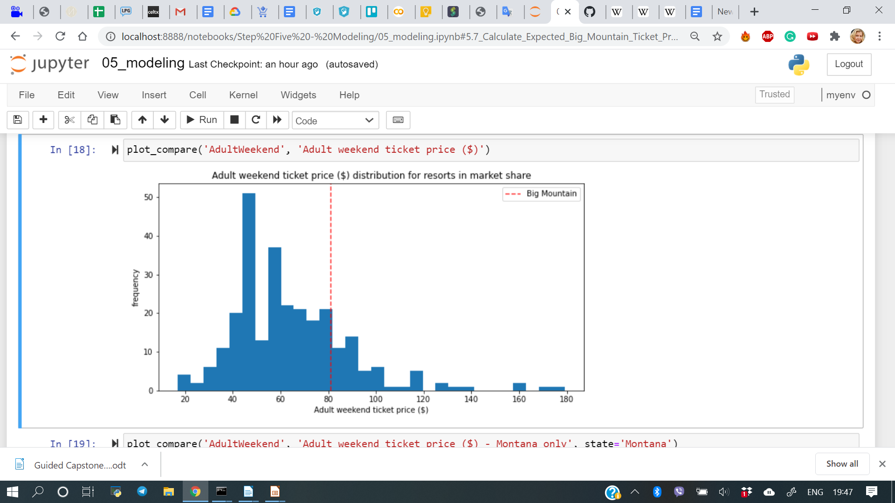
Current Challenges
- to increase the ticket price, to reflect the actual value compared to competitors' data
- to cover equipment operating cost

Slide 5
Recommendation and key findings
Current ticket price - $81
$1.99 increase will safely create additional income of $3,474,638
and will cover operating cost increase of $1,540,000
and even more ...

Slide 6
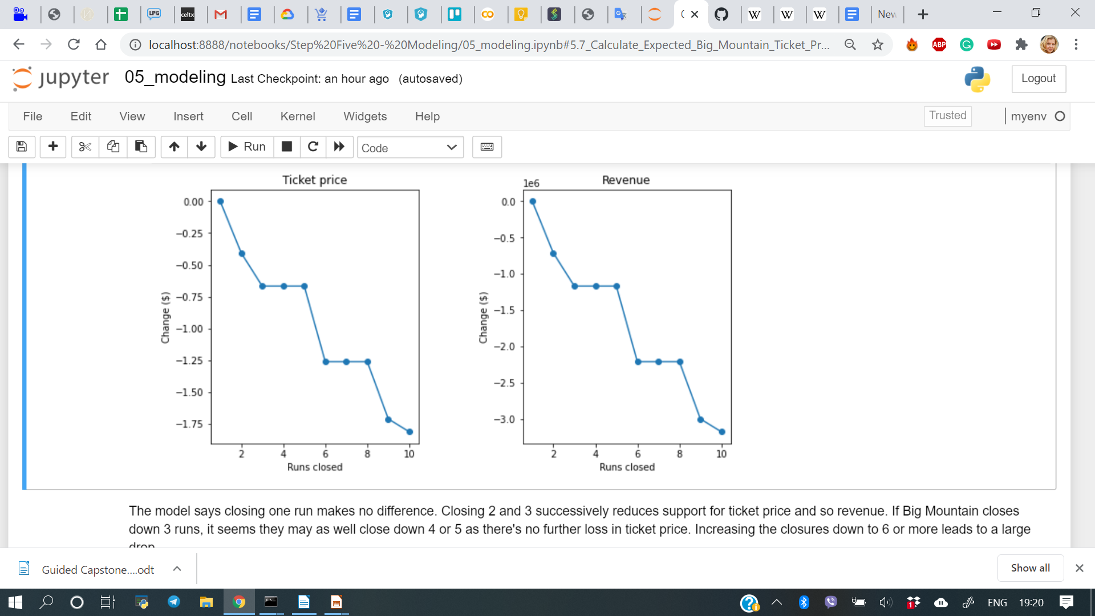
Option: Closing runs
1 closed run - $0 price decrease
2 closed runs -$0.41 price decrease
3, 4, 5 - $0.67 price decrease
6 and more - $1.26 price decrease

Slide 7
Modeling results and analysis
1. Adding a run, increasing the vertical drop by 150 feet, installing an additional chair lift
- no difference to the price
2. Same as before plus 2 acres of snow making
- no difference
3. Increasing the longest run by .2 miles plus snow coverage of 4 acres
- no difference

Slide 8
Summary and recommendtions
Increase ticket price at $1.99
Close 1, 2 or 5 runs at a time if necessary
No adjustments of the area or equipment are needed to increase the price

